Slide 1

NLP - TOXIC COMMENT CLASSIFICATION
by: Viktoria Szontagh

Slide 2





AGENDA
Business Case
Data
Modeling
Best Model
Limitations

Slide 3


BUSINESS CASE
Monitoring Online Discussion Forum
- Company XYZ operating an online discussion forum
- New to market
- Inexperienced in content moderation
- Limited resurces for content moderation

Slide 4



DATA
Kaggle Toxic Comment Classification Challenge
Wikipedia comments from users
144,277
Normal
15,294
Toxic
159,571
Total

Slide 5
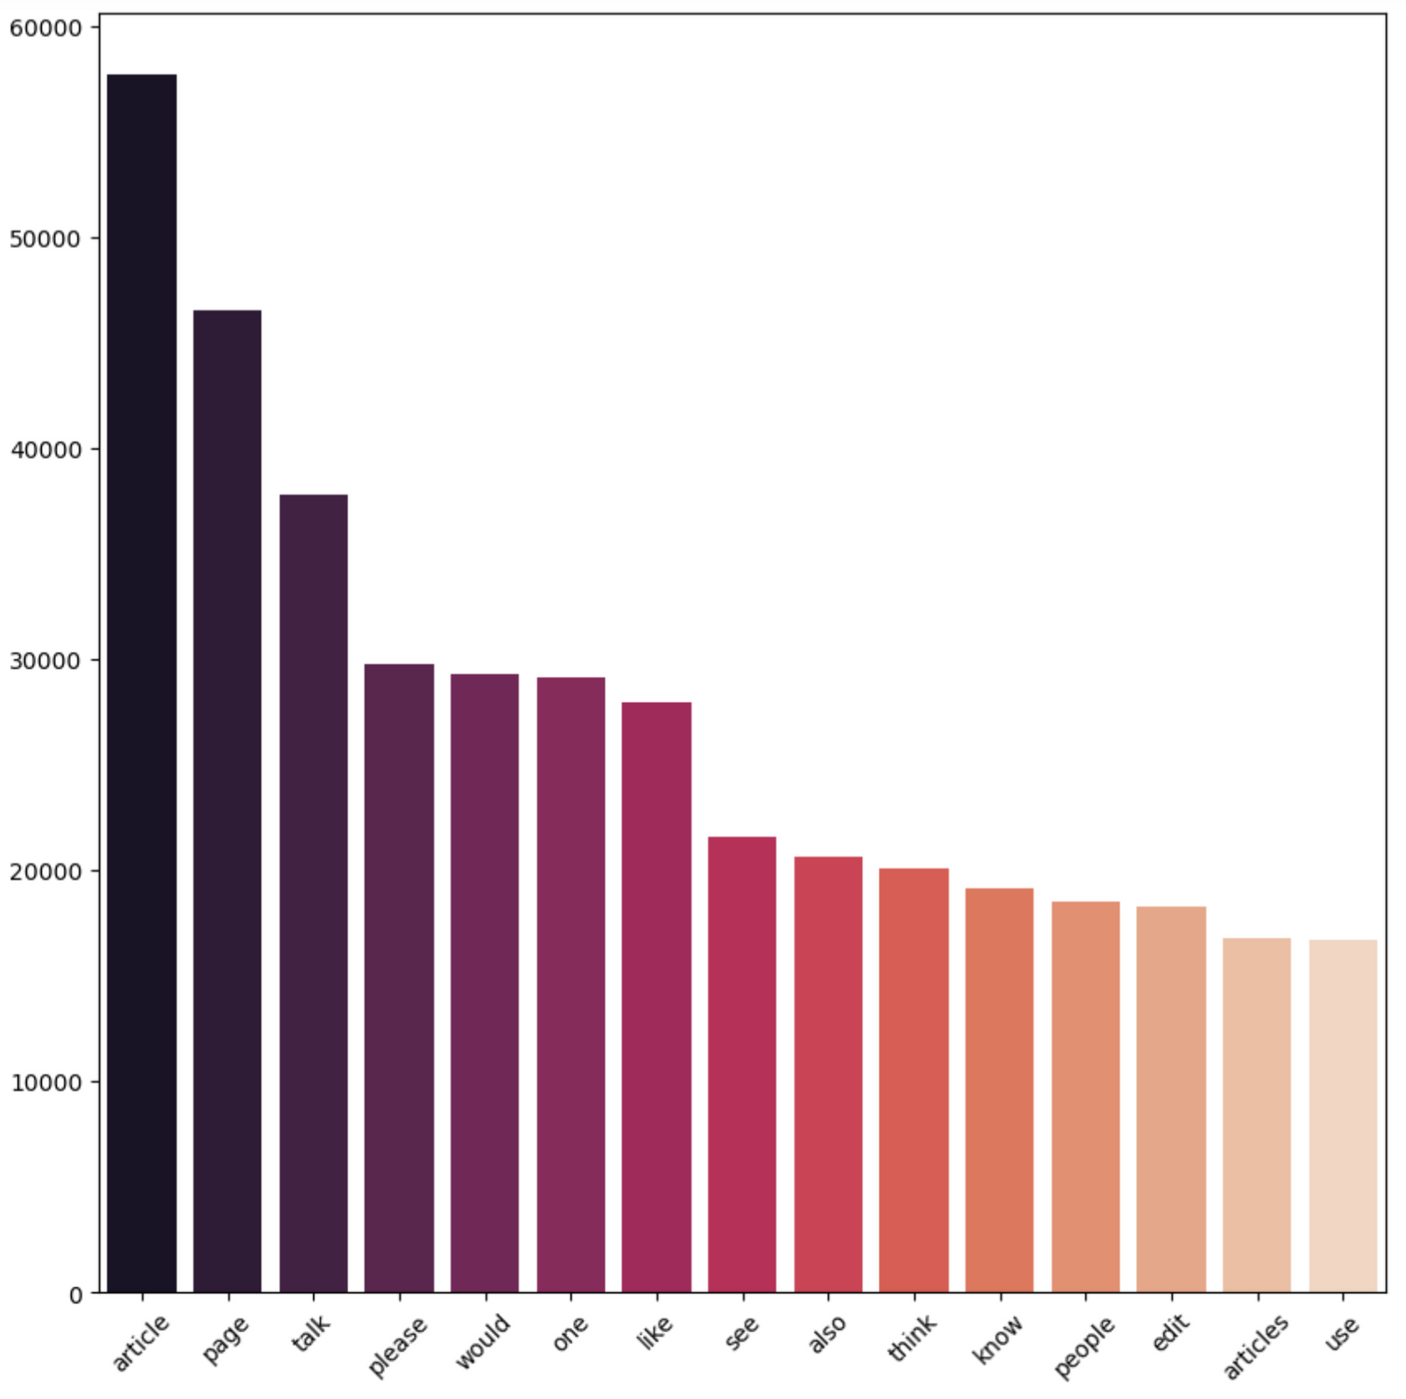
Top 20 Words

Slide 6
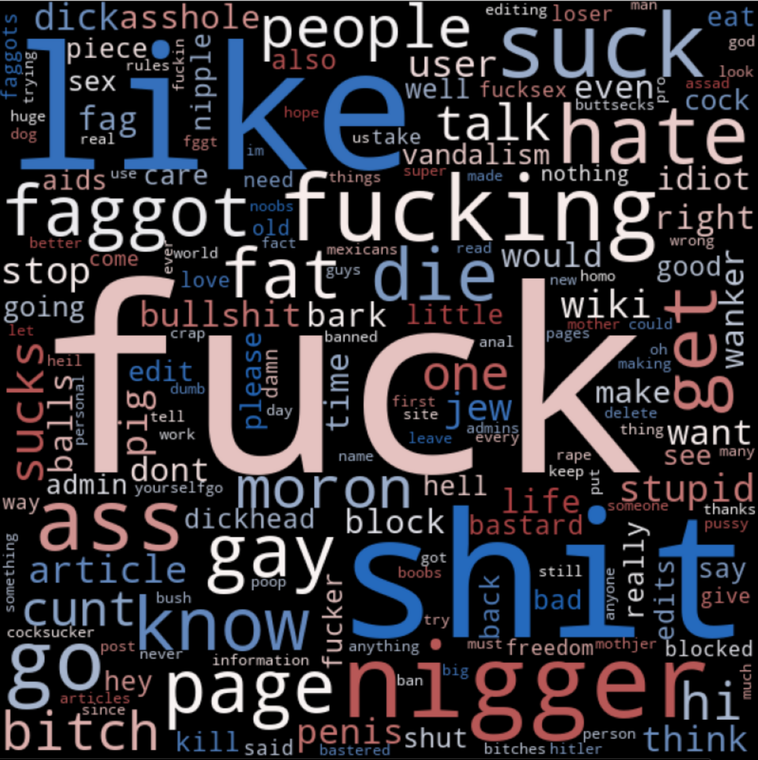

TOP 20 TOXIC WORDS

Slide 7



Toxic Comments
STUPID PEACE OF SHIT STOP DELETING MY STUFF ASSHOLE GO DIE AND FALL IN A HOLE GO TO HELL!
WHOEVER PUT A NOTICES ON MY PAGE. I WILL KILL U
BLA BLA BLA....SUCK IT IRISHGUY =)
A
B
C
Normal Comments
I AM MOST CERTAINLY NOT A SOCKPUPPET OF THECHIEF, PLEASE RETRACT YOUR FRADULENT CLAIM AT ONCE.
- NEILN'S BANG ON - YOU AREN'T BEING HARASSED AT ALL, IF YOU DON'T EDIT DISRUPTIVELY YOU DON'T GET REVERTED.
YOU, SIR, ARE MY HERO. ANY CHANCE YOU REMEMBER WHAT PAGE THAT'S ON?
X
Y
Z

Slide 8

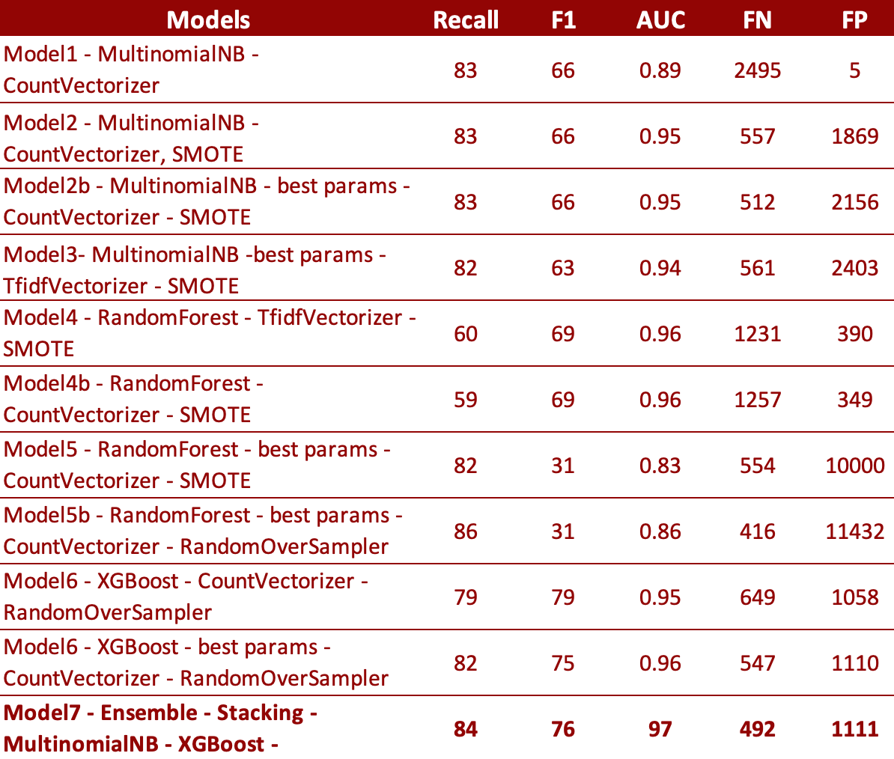
Models

Slide 9
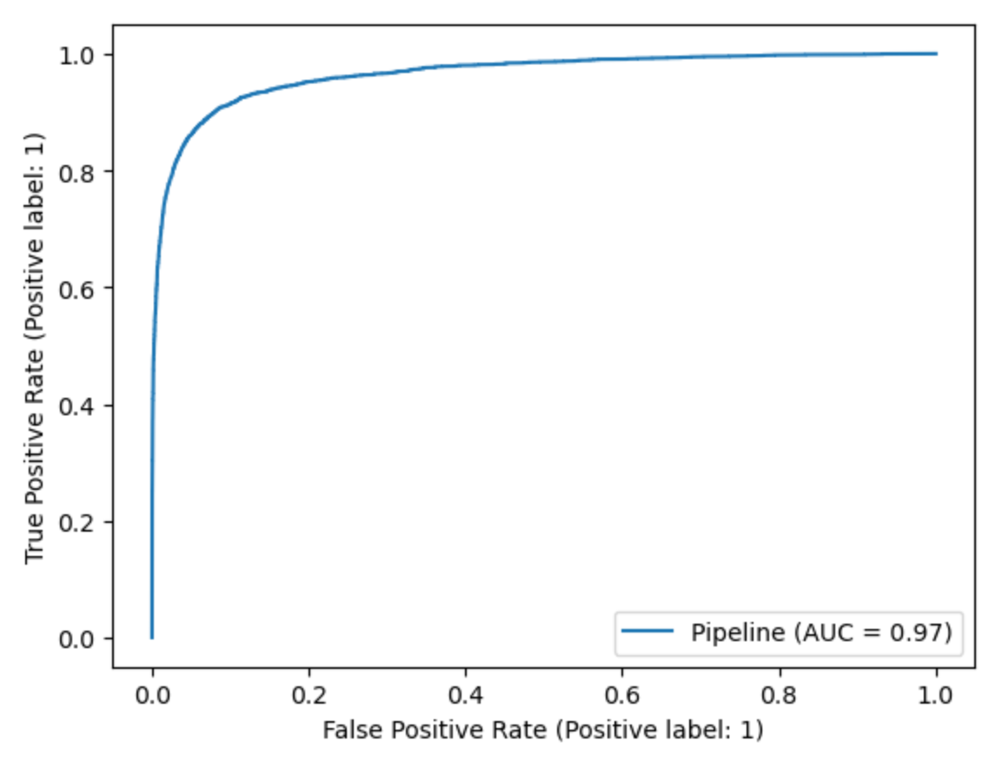
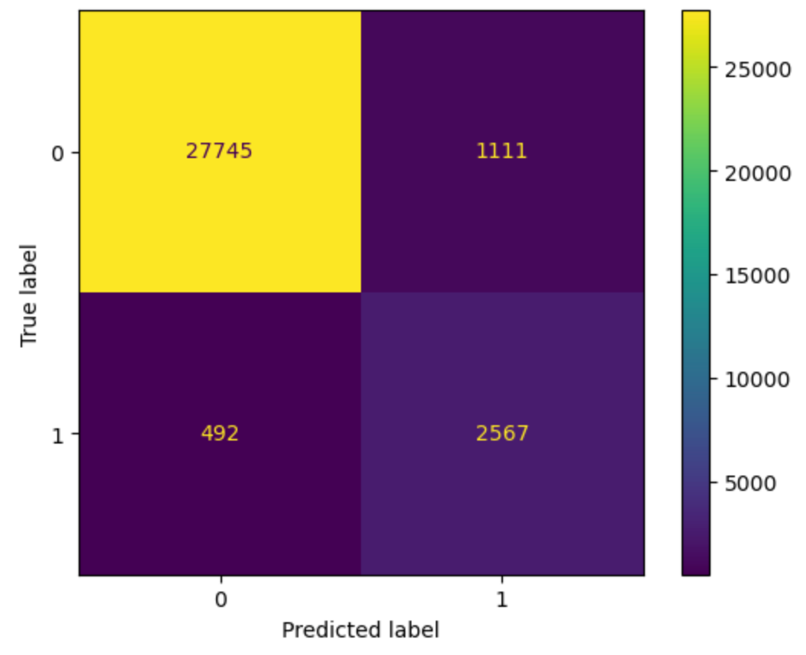

Slide 10









Limitations
NAZI FILTH“” IS IMPOLITE
YOU ARE ONE SAD LITTLE INDIVIDUAL.
Andrew
Fredrik
YOU DISGRACE TO HUMANITY. STOP WASTING VALUABLE INTERNET RESOURCES (YOUR KILLING THE FUCKING PLANET) AND THROW OUT YOUR PC. PS IT'S LIKE 3AM WHAT THE FARK KINDA LIFE DO YOU HAVE ON WIKIPEDIA 24/7. A VERY SAD AND LONELY ONE LOL. LIFE'S TOO SHORT FIND SOMETHING BETTER TO DO
ANTI-SEMITIC CRAP
THE WHOLE ARTICLE IS AN ANTI-SEMITIC CONSPIRACY THEORY CHERISHED BY ARYAN-SUPREMACIST RIGHTISTS!
Rachel
Type name

Slide 11



THANK YOU
https://github.com/vszontagh
vikkiszontagh@gmail.com

